Slide 1
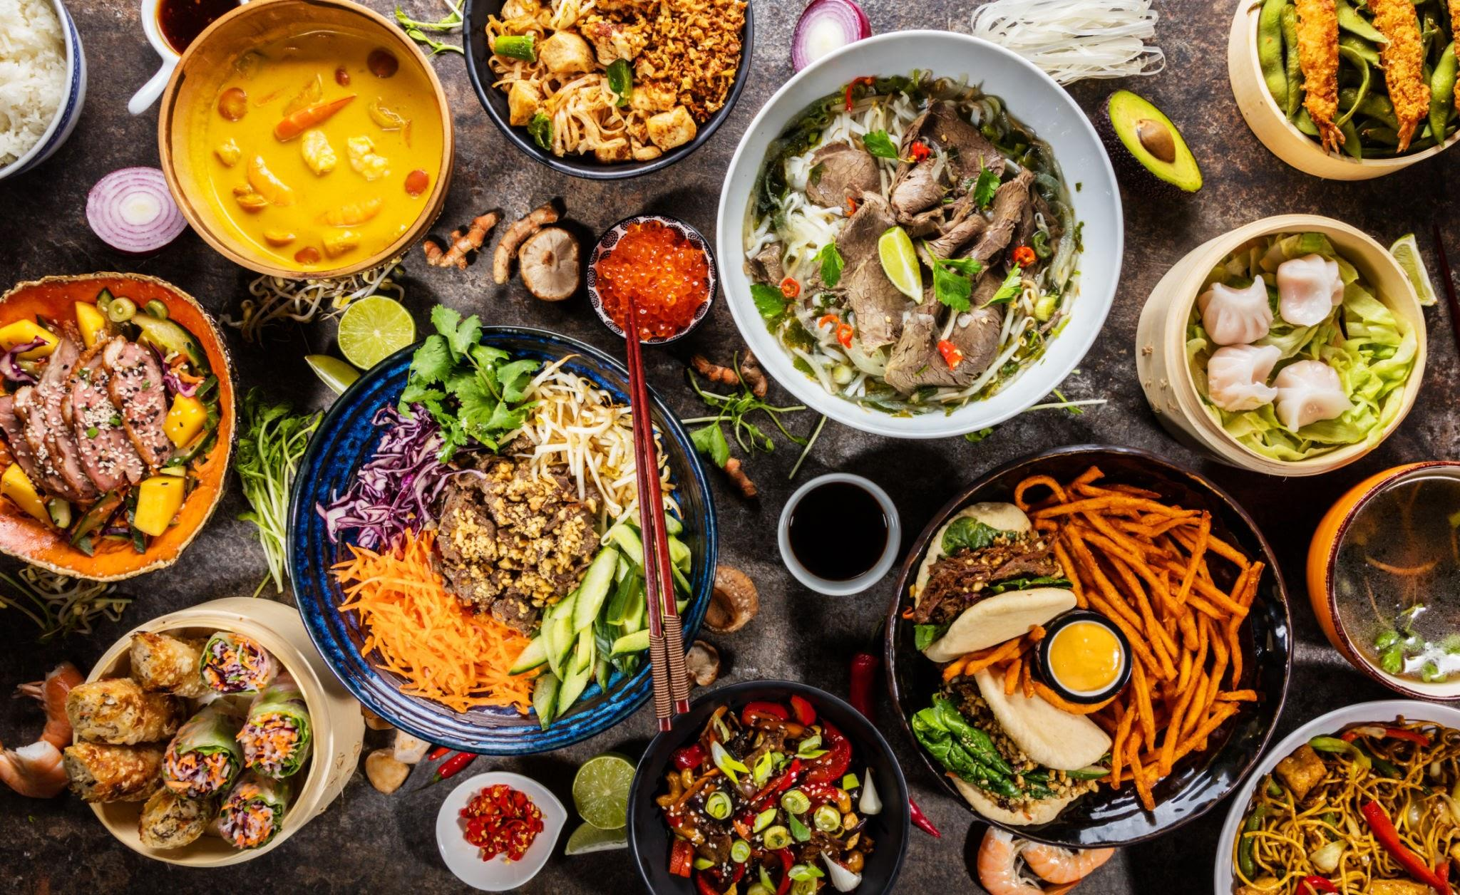

WSWE: A Graph-Augmented RAG System for Personalized Restaurant Discovery
By: Prisca Varner, Grace Lin, Bagya Puppala, Janani Vakkanti, Somil Gupta, Mauro Cardona Reyes

Slide 2
01
02
03
04
TABLE OF CONTENTS
05
Project Relevance
The Dataset
Network Analysis
Model Architecture
Demo

Slide 3
Project Relevance
01

Slide 4
The Problem
OpenTable
Yelp
Google Maps
The Gap
You can book, but you already have to know where you want to go.
You can search, but only if you know the right keywords
Shows you everything nearby; understands nothing about context
None of them can answer: “find me something calm and romantic for a first date that isn’t too expensive” in a single conversational turn.

Slide 5
The Purpose of WSWE (Where Should We Eat?)
Natural Language
Community Detection
Review-driven RAG
Smart follow-up
Knowledge Graph
Scalable Architecture
Describe what you want, no rigid filters needed
Graph clusters restaurants by shared cuisine and vibe
Retrieves what customers actually experienced not just tags
Asks one targeted question when intent is incomplete
82k nodes, 103k edges connecting restaurants, users, reviews
Any city, any domain - plug in a new dataset and go!

Slide 6
02
The Dataset

Slide 7
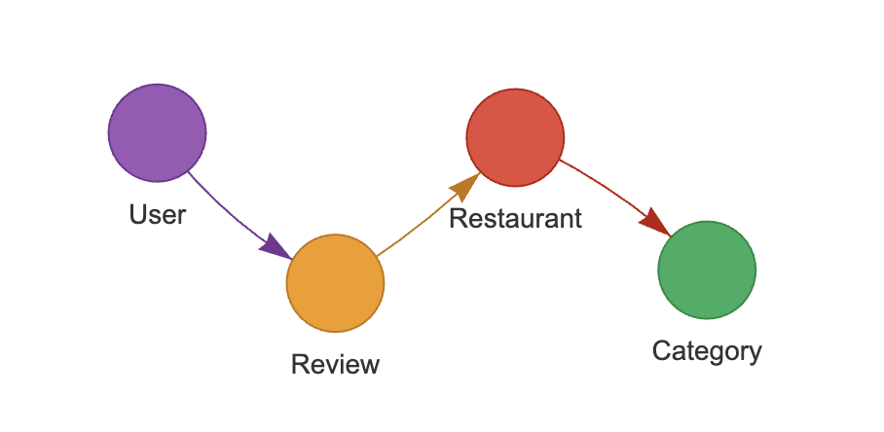
Data Composition
Yelp Dataset
Filtering
Nodes
Edges
Categories
150K+ Businesses
1M+ Users
11 Metro areas
Filter to only top Restaurants in Philadelphia
82,502 Nodes
(499 restaurants, 31,793 users, 50,000 reviews, 210 categories)
103,775 Edges
(User→Review, Review→Restaurant, Restaurant→Category)
Cuisine types, price (1–4), attire (casual/dressy), ambience tags

Slide 8
Network Analysis
03

Slide 9
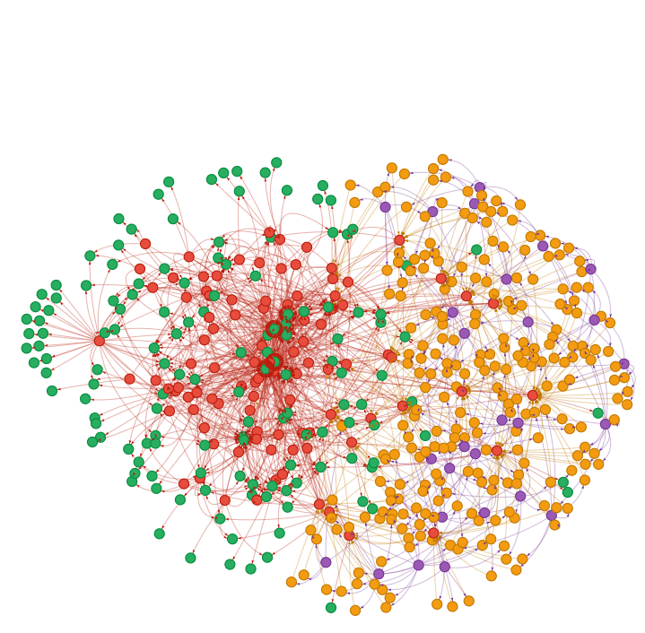
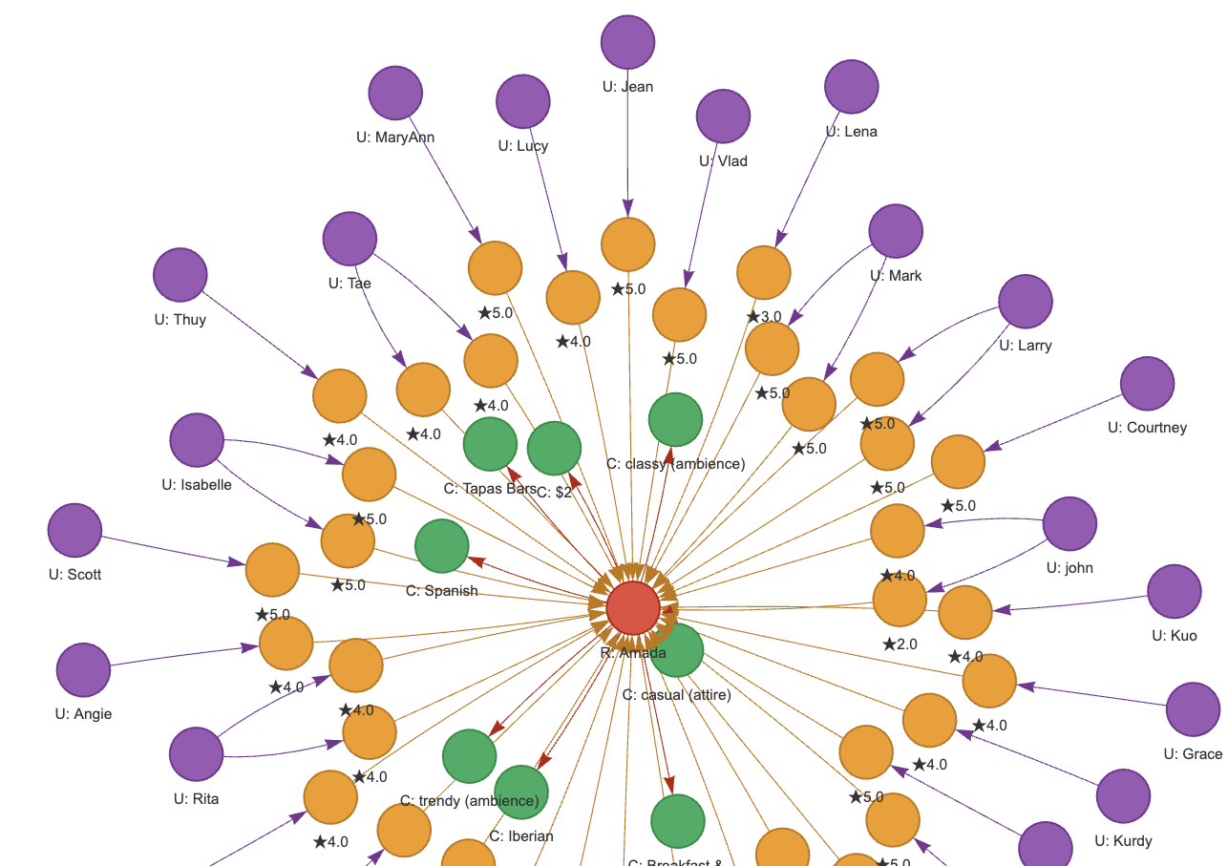

How Network Was Made
NETWORK FEATURES
Zoom in →
Restaurant Amada Example

Slide 10
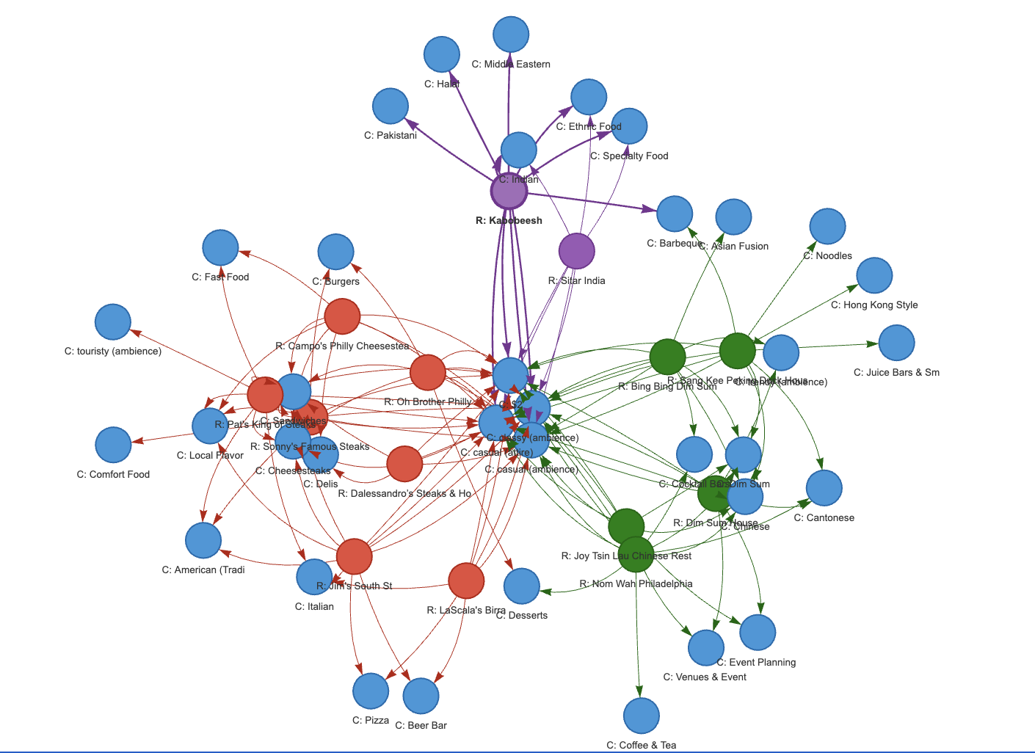
How Network Was Made
NETWORK FEATURES

Slide 11
How Communities Were Made
COMMUNITY FEATURES
FINAL COMMUNITIES
Bipartite Graph
Attributes:
Cuisine and Ambiance
Filtered out:
Price and Attire
Common Cuisines: “Restaurant”, “Breakfast & Brunch
Common Ambiance: “Casual”, “Classy”
Min Attributes Shared:
2
Coffee & Dessert Cafés
Upscale Romantic Dining
Gastropubs & Bars
Beer Bars
Cheesesteaks & Sandwich Shops
Chinese / Dim Sum
Vegan & Vegetarian
Japanese / Sushi
Italian / Pizza
Mexican / Tacos
Diners
Notes:
To construct restaurant communities, we built a bipartite network connecting restaurants to their attributes. (Using Louvain Method)
The attributes we used were primarily cuisine tags and ambience tags, since these capture the type of food and the dining experience.
We removed a few variables such as price and attire, and also filtered out extremely common tags These tags appear across too many restaurants and would create overly dense connections in the network.
After filtering, we projected the bipartite network into a restaurant-to-restaurant communities, where two restaurants are connected if they share at least two attributes.
We then applied community detection to identify clusters of restaurants that share similar characteristics.
This process produced 11 distinct restaurant communities, such as coffee and dessert cafés, gastropubs and bars, sushi restaurants, Italian and pizza spots, Mexican restaurants, and others.

Slide 12
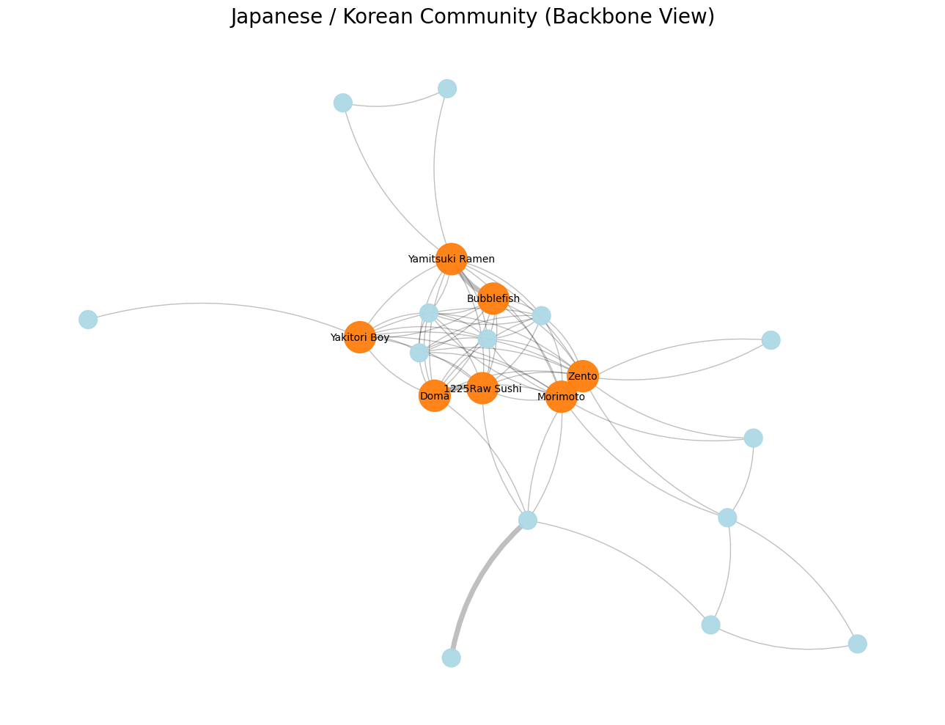
How Communities Were Made
COMMUNITY EXAMPLE
Top tags:
Japanese, Sushi Bars, trendy, Asian Fusion, Korean
32 restaurants | Mixed price range $–$$$
Examples:
Bleu Sushi, Bonchon Philadelphia, Aki Nom Nom Sushi & Ramen
Tight cluster — sushi and Korean share trendy, casual ambience and Asian fusion overlap
Notes:
Here we show an example of one detected cluster: the Japanese and Korean restaurant community.
Each node represents a restaurant, and edges connect restaurants that share multiple attributes
Here we only display the strongest connections, meaning restaurants that share at least three attributes. The orange nodes represent the most central restaurants in the community. These restaurants share many attributes with others and effectively form the core of the cluster.
Overall, the cluster demonstrates how restaurants naturally group together based on shared attributes, revealing underlying structure in the restaurant ecosystem.
These communities become a foundational part of our recommendation system, since they allow us to identify restaurants that are structurally similar in the network.

Slide 13
Model Architecture
04

Slide 14
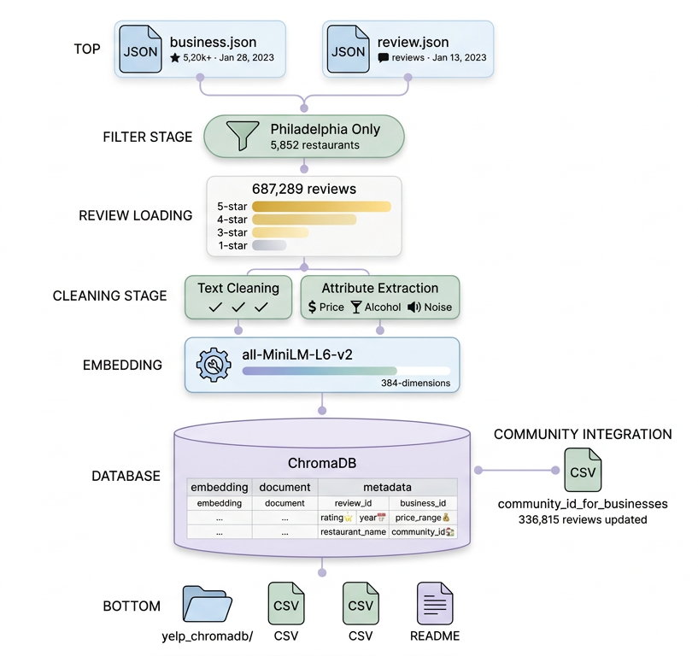
Vector Embeddings
DATA VOLUME
PROCESSING
COMMUNITY INTEGRATION
METADATA
5,852 Philadelphia restaurants
687,289 reviews loaded
2.5 GB vector database
Model: all-MiniLM-L6-v2
Dimensions: 384
Runtime: 101 minutes
Review_id - business_id
rating - year
price_range
restaurant_name
community_id
500 business mappings
336,815 reviews tagged
484 businesses with community IDs
Communities 0-10

Slide 15
LangGraph Orchestration
User Query
LMM Parsing
LangGraph State Routing
Retrieval Call
Accepts Natural Language Request from user describing their preferences.
What’s a fun but classy sushi place to take my girlfriend for our anniversary?
Uses the Gemini API to parse query and extract structured fields.
Manages workflow state and determines next action. Validates parsed output for required fields.
Structured query is sent to retrieval pipeline.
cuisine = sushi, japanese vibe = lively, classy, romantic party_size = 2 group_type = couple
price_range = missing
missing _fields = [“price”]
“What price range should I target?”
cuisine: ["sushi", "japanese"],
vibe: [lively, classy, romantic],
price_range: 3,
party_size: 2,
group_type: couple,
Notes:
The Langgraph Orchestration identifies what the User wants from their natural language conversation in the front end and passes it on to the rest of the system. So let say the user wants a “fun and classy sushi restaurant for our anniversary”
Then we use an LLM parser to identify what information we want to extract from fields. Using an LLM allows more flexibility and intelligence so the user can be more casual and we’d still extract meaningful information and so things like anniversary might already determine this is a party_size = 2 without it fitting into a rigid string search.
Then this results is validated in the LangGraph State Routing section. Before doing this entire part i should mention, we created an agreement with our recommendation side for what fields would be extracted. As you can see, cuisine, vibe, party_size, group_type, price_range and a few more like “avoid” are in this with price and cuisine being required. The state routing ensures we have the two required fields required for our model to and reprompts creating a Human In the Loop interaction when it does not. (i.e. what price range)
Finally, we send all of this information to the rest of our system in a predetermined format. Currently locally but can use APIs.

Slide 16
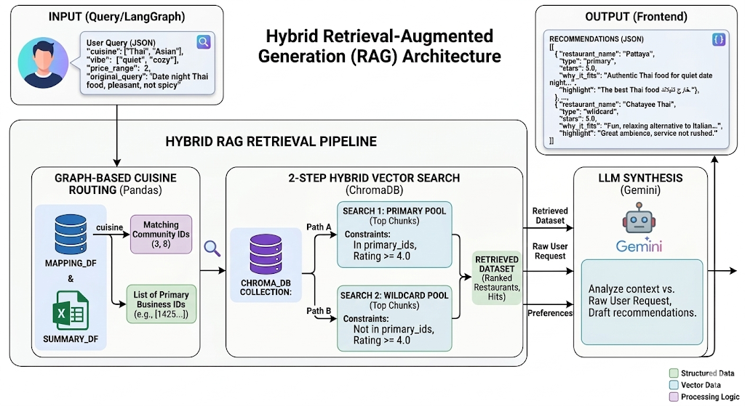
RAG Pipeline

Slide 17
05
Demo
Demonstrating the Benefits

Slide 18
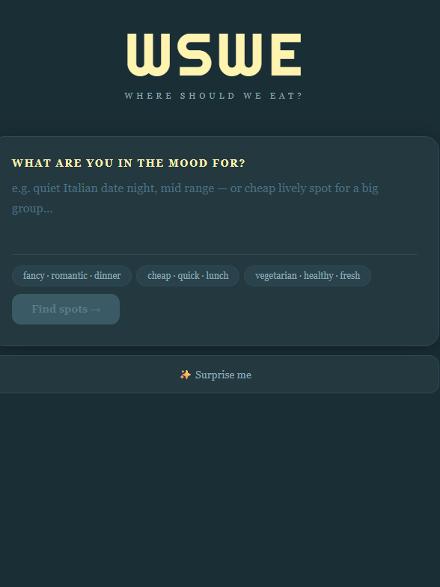
WSWE:
Where Should We Eat?
A conversational restaurant discovery agent for Philadelphia.
Just describe what you're in the mood for; WSWE asks a follow-up question if needed, then returns personalized picks pulled from real customer reviews.
No filters. No scrolling. Just tell it what you want.

Slide 19
Future Scope
Expand Geography
Upgrade Embedding Models
Real-Time Updates
Strengthens understanding of user reviews for better recommendations for a given query expectation.
Sentiment & Aspect Analysis
3rd Party INTEGRATION
Adding User Profiles
Currently limited to Philadelphia restaurants. Can add restaurants across the nation for national coverage.
Utilize current user datetime to filter out closed restaurants if the user wants something now.
Store user restaurant response data for better future recommendations.
Users can create their own reviews and save restaurants within the app.
Will better contextualize and understand user reviews according to what a restaurant does well and poorly.
Integrate with delivery apps (e.g. UBER eats) to help users choose their restaurant within the app.
Interface with company apps to automatically route them to their websites/apps or OpenTable.

Slide 20
Questions?

Slide 21
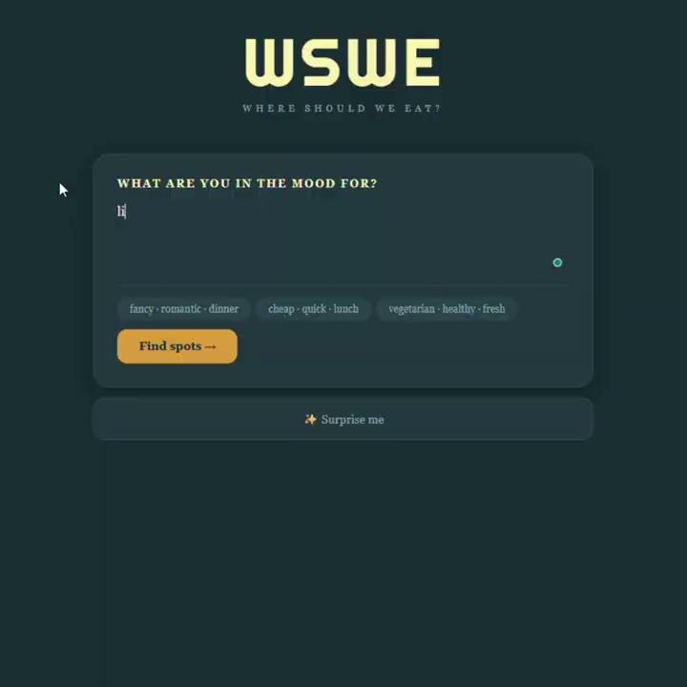
Appendix-DEMO VIDEO
A conversational restaurant discovery agent for Philadelphia.
Just describe what you're in the mood for; WSWE asks a follow-up question if needed, then returns personalized picks pulled from real customer reviews.
No filters. No scrolling. Just tell it what you want.

